Slide 1
Ozone Season
Exploratory Analysis of Qualitative Trends in the Ozone Season
Brandon Neal, Phillip Rodriguez-Lebron and Siyu Duan

Slide 2
Background
Purpose:
Characterize the long-term changes in the ozone season.
Examine the seasonal patterns of ground level ozone and the relationship between ozone concentration and temperature.
Data collection:
Using daily ozone and meteorology data for 35 major U.S. cities, collected from monitoring networks by EPA (Environmental Protection Agency) during 1990-2016.

Slide 3
Terminology
Ground Level Ozone (O₃)
Air pollutant w/ negative impacts on health and environment
Largely due to emissions
Levels higher on warm, sunny days
Ozone concentration
Amount of ozone in atmosphere
Measured in parts per million (ppm)
Naturally occurs around .010 ppm
Ozone season
Period of time w/ elevated levels of ozone
Other
Max daily temperature
Max ozone concentration for 8 hours
Notes:
Phillip

Slide 4
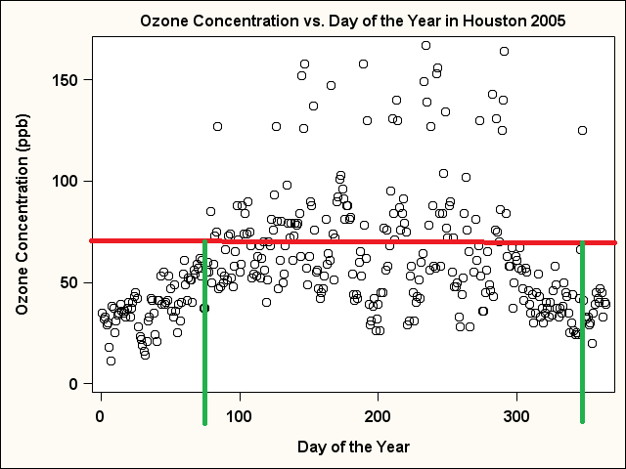
Question 1
Is the ozone season shifting over time?
High ozone = concentration > 70 ppb
First observed high ozone day earlier or later.
Beginning Day
Last observed high ozone day earlier or later.
End Day

Slide 5
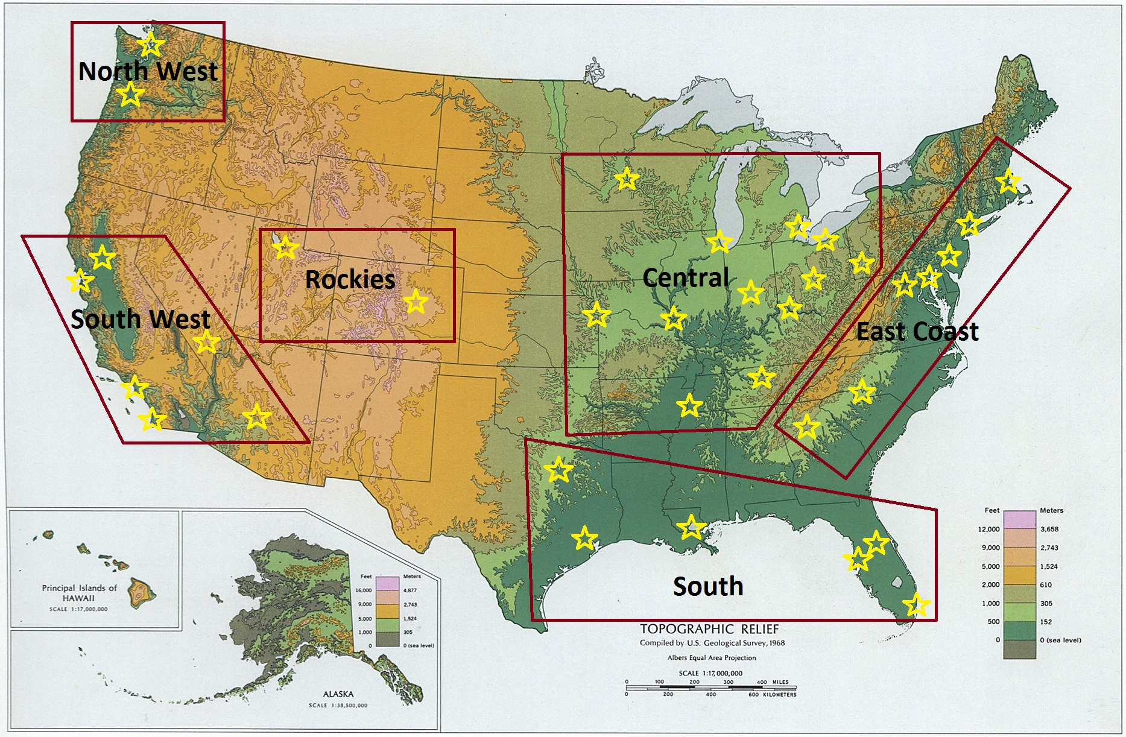
Regions
East Coast
South
Central
Rockies
South West
North West

Slide 6
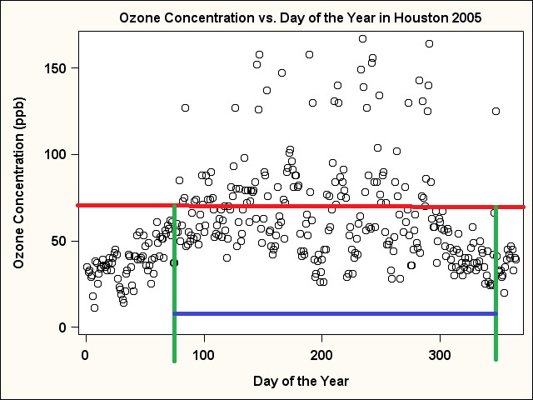
Question 2
Ozone season
Shortening or lengthening?
Interval =
Last Day - First Day

Slide 7
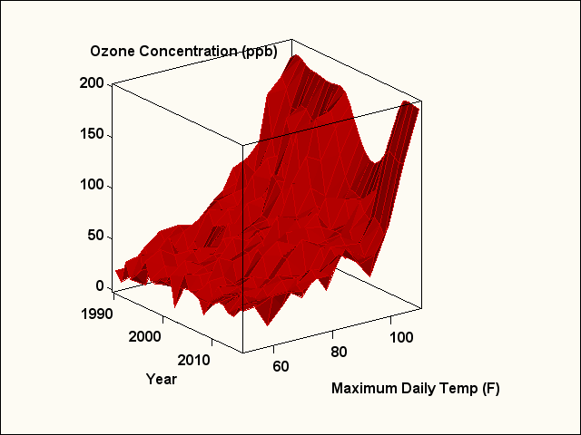
Question 3
Part 1:
Is the relationship between daily ozone concentration and daily maximum temperature changing over time?

Slide 8
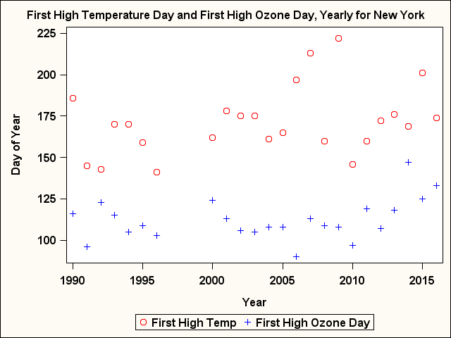
Question 3
Part 2:
High temperature=temperature > 90 F
Is there a relationship between
First observed high temperature day and first observed high ozone day
Last observed high temperature day and last observed high ozone day

Slide 9
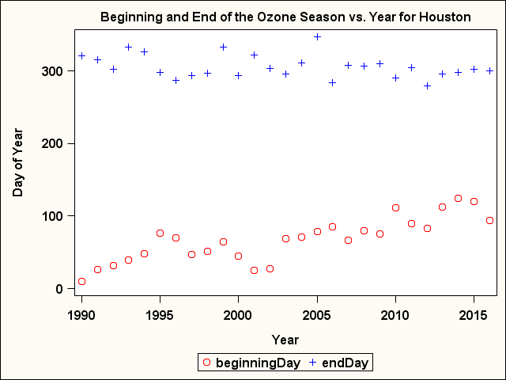
Methods for Season Shift
Plotted beginning day vs. year.
Plotted end day vs. year.
Look for a pattern. Fit a model.
Day = ß₀ + ß₁(year)
Day = ß₀ + ß₁(exp(year))
Day = ß₀+ ß₁(exp(-year))
Day = ß₀ + ß₁(year) + ß₂(year^2)
Determine if the model coefficient was statistically significant and note the sign of the coefficient.

Slide 10
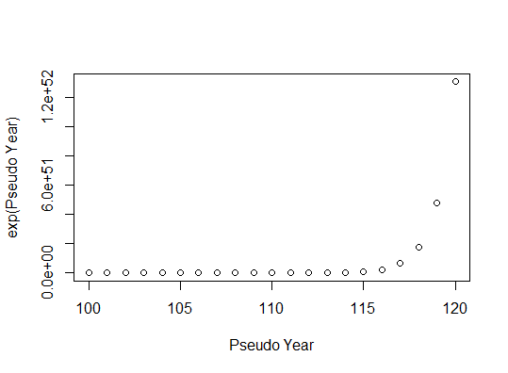
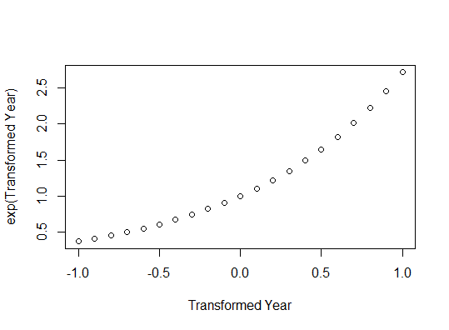
Methods for Season Shift

Slide 11
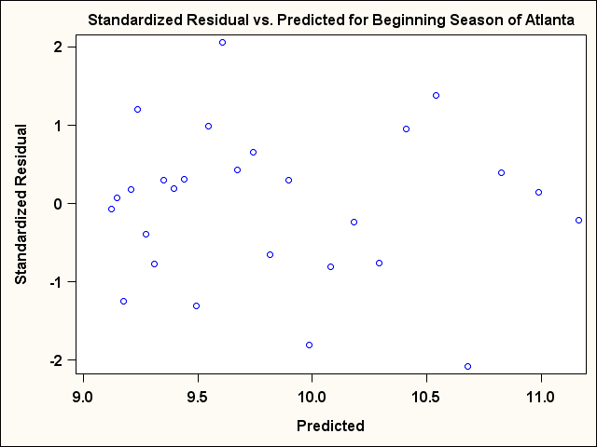
Methods for Season Shift
Highest R2
Regression Assumptions

Slide 12
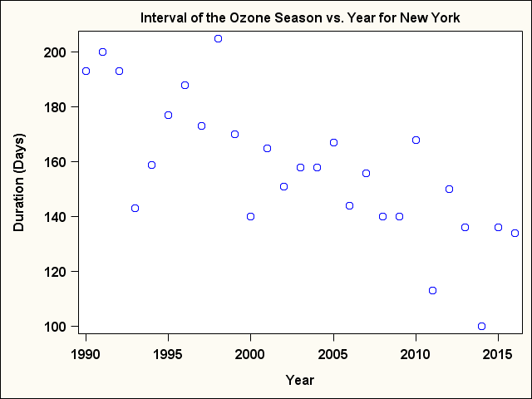
Methods for Season Duration Change
Plotted interval vs. year.
Look for a pattern. Fit a model.
Day = ß₀ + ß₁(year)
Day = ß₀ + ß₁(exp(year))
Day = ß₀ + ß₁(exp(-year))
Day = ß₀ + ß₁(year) + ß₂(year^2)
Determine if the model coefficient was statistically significant and note the sign of the coefficient.

Slide 13
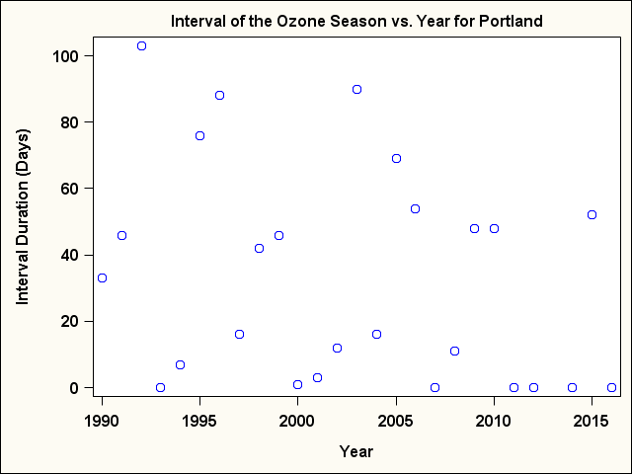
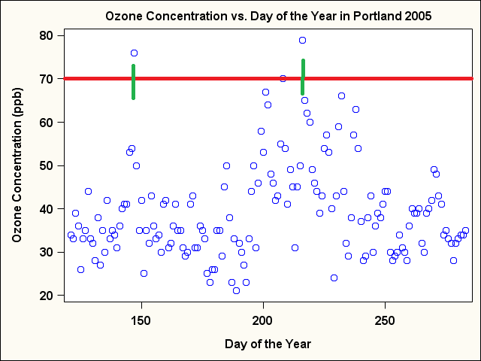
Additional Considerations for Season Duration Change
Plotted interval vs. year.
If ozone concentration not > 70 ppb
Zero values for interval.

Slide 14
Methods for relationships of shifts
Part 1:
Fit Autoregressive Moving Average Model
E(daily ozone concentration)=
ß₀ + ß₁ * daily maximum temperature + ß₂ * year + ß₃ *stagnation index + ß₄ * actual day of that year + ß₅ * year* daily maximum temperature + ß₆ * daily maximum temperature ²+ ß₆ * actual day of that year²
General form:
y_{t} = E( y_{t} ) + R_{t}
E( y_{t} ) = ß₀ + ß₁x₁ + … + ß_{k}x_{k}
Conduct t-test for the interaction term →
Determine if it is statistically significant → Note the sign of the coefficient

Slide 15
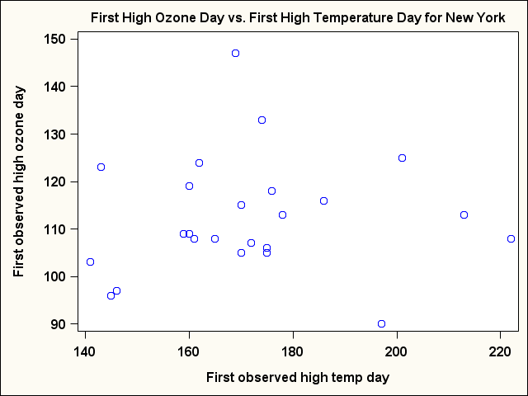
Cont. Method for relationship of shifts
Part 2:
Use General Linear Model to plot:
First observed high ozone day VS. first observed high temperature day
Last observed high ozone day VS. last observed high temperature day
Any relationship??

Slide 16
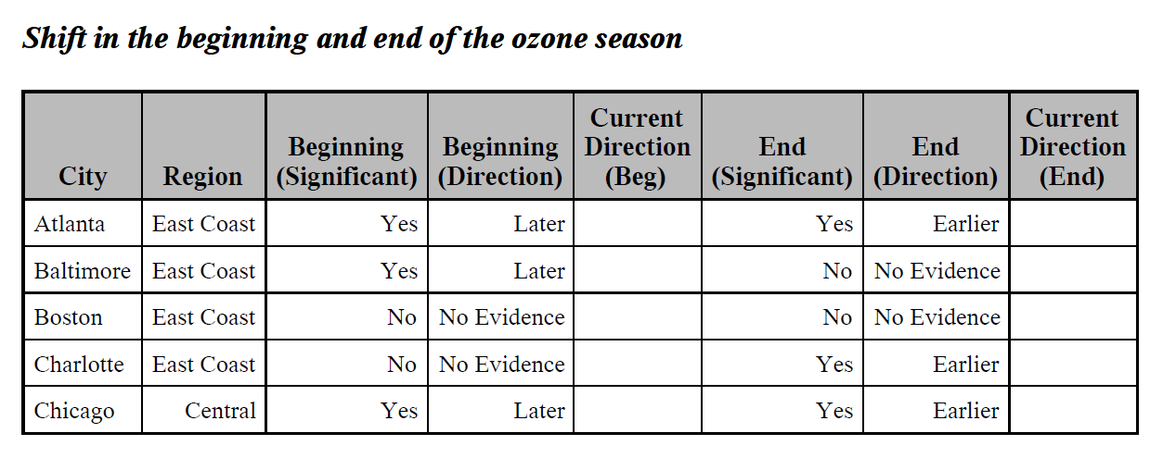
Results for Ozone Season Shift

Slide 17
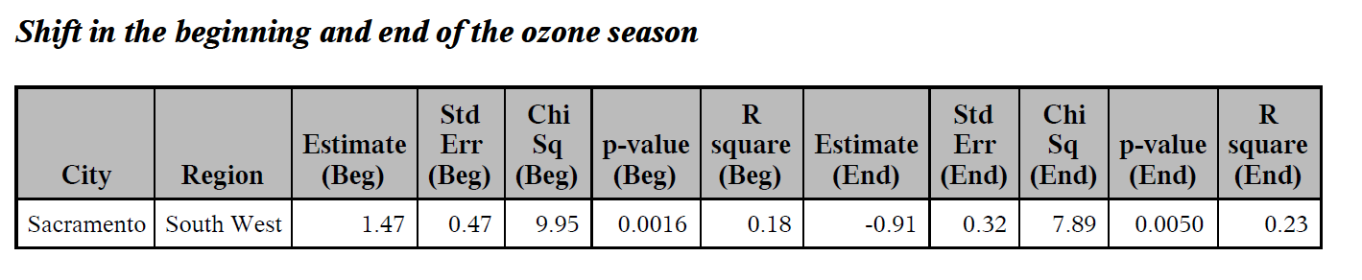
Results for Ozone Season Shift

Slide 18
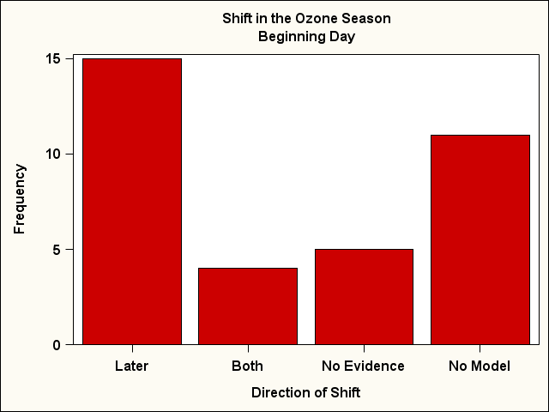
Results for Ozone Season Shift (Beginning of Season)

Slide 19
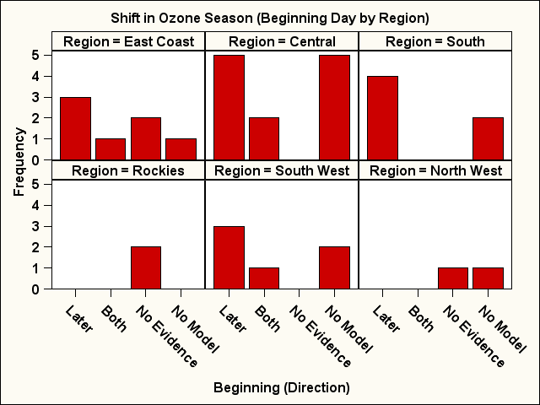
Results for Ozone Season Shift (Beginning of Season)

Slide 20
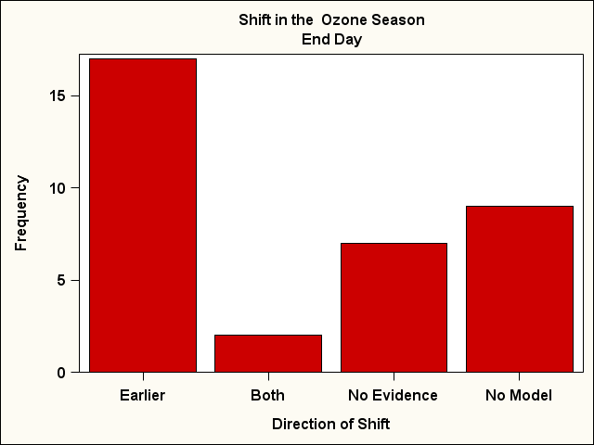
Results for Ozone Season Shift (End of Season)

Slide 21
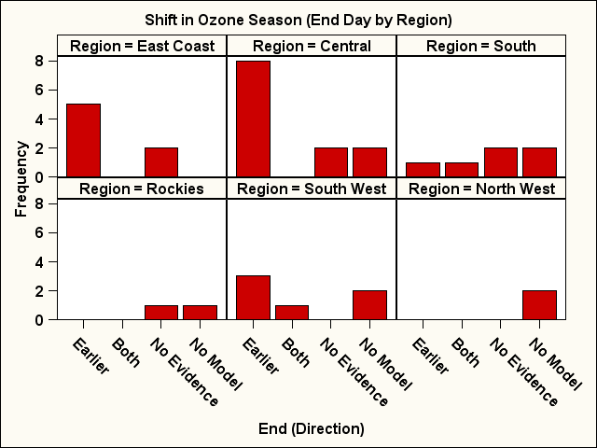
Results for Ozone Season Shift (End of Season)

Slide 22
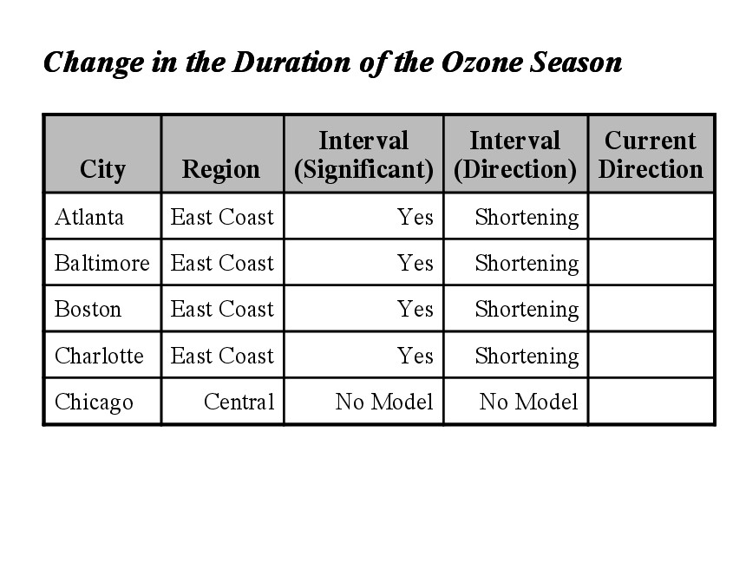
Results for Ozone Season Duration
Interval of the Season
For each city:
Model (Yes)
Significant? (Yes)
Direction of Trend (Shorter Longer)
Significant? (No)
Report no evidence.
Model (No)
Nothing is stated for that city.

Slide 23
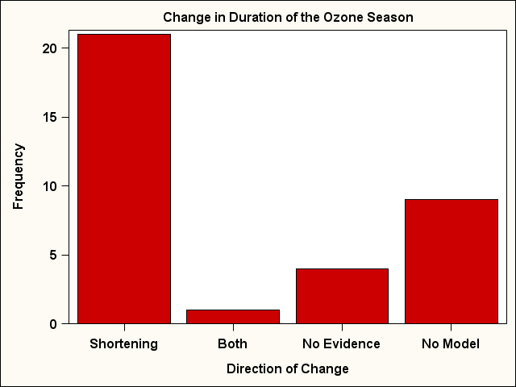
Results for Ozone Season Duration

Slide 24
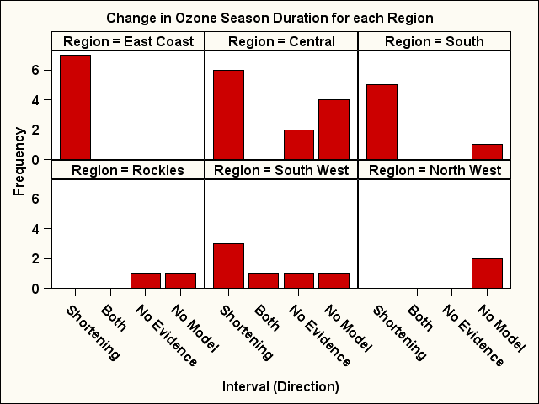
Results for Ozone Season Duration

Slide 25
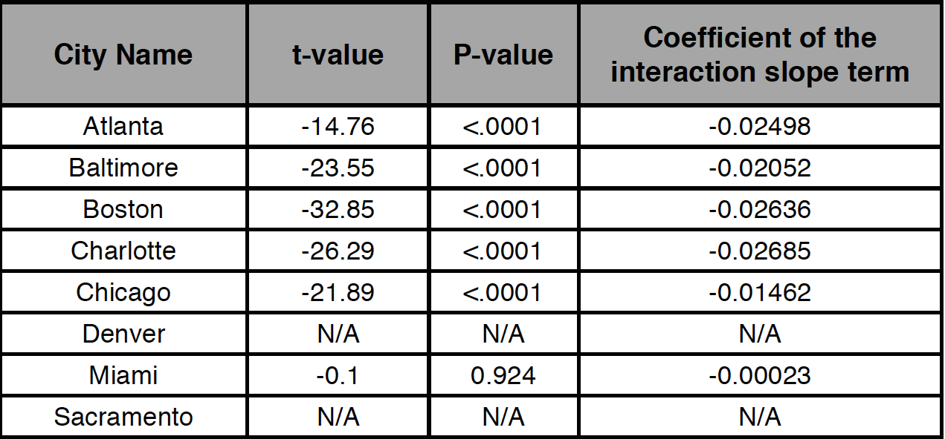
Results for Interaction of Daily Ozone Concentration and Daily Max Temperature Over Time
Part 1:
91% cities had statistically significant interaction slope term
Average coefficient is -0.02
N/As?

Slide 26
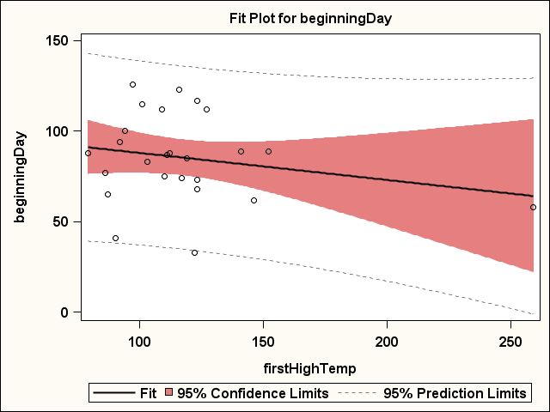
Results for Relationship Between First High Ozone Day and First High Temperature Day
Example: Orlando
1999 Day 259 (August)

Slide 27
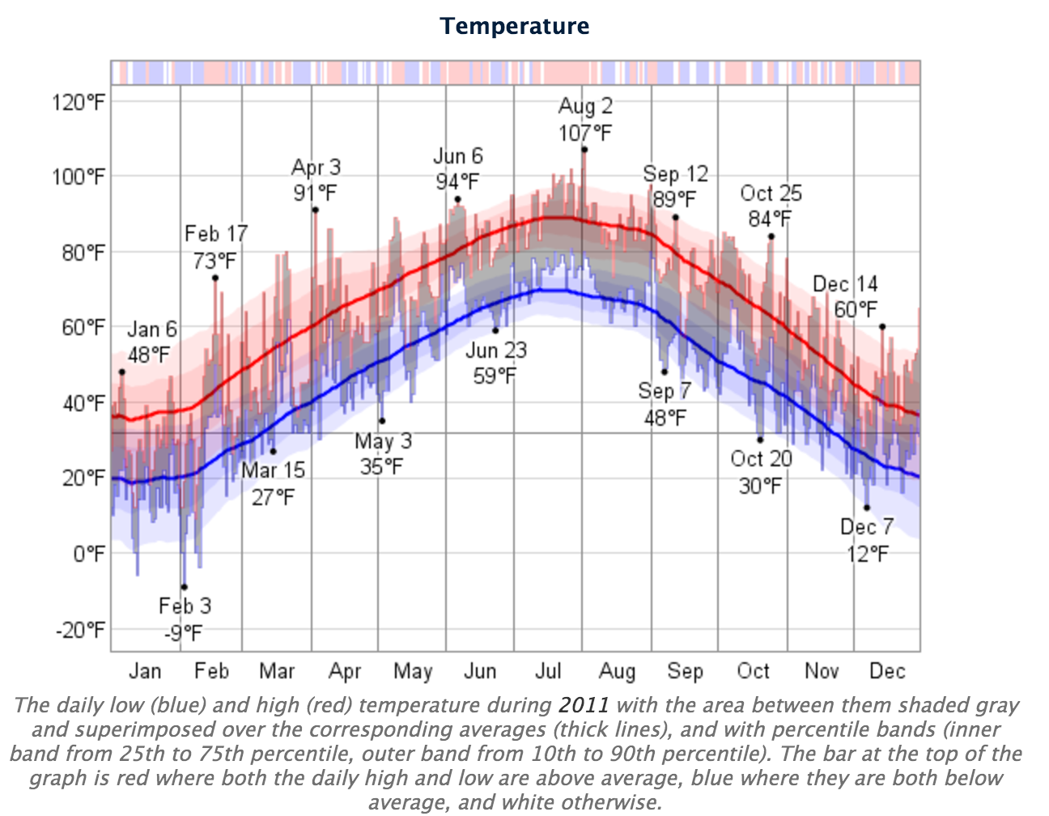
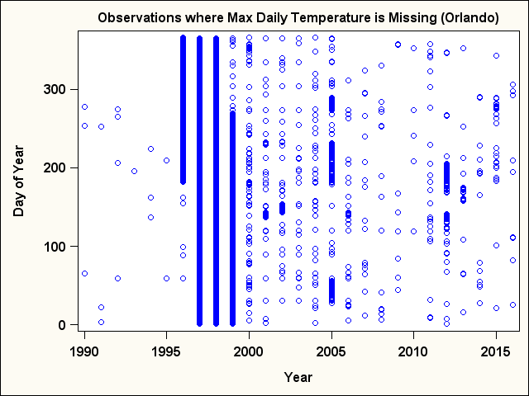
Missing daily maximum temperature over years
Observed first high temperature day
Actual first high temperature day
https://weatherspark.com

Slide 28
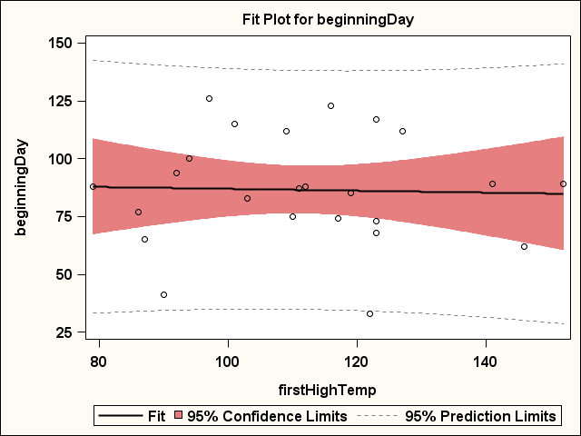
Cont. Orlando
After removing 1999
R-square = 0.002
Still no strong relationship

Slide 29
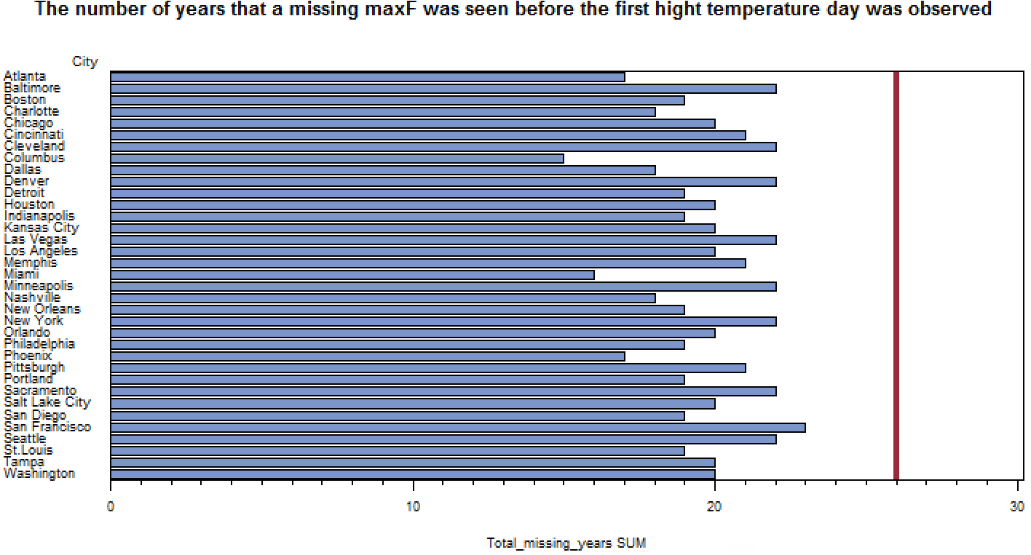
Total years where there are missing daily maximum temperature before the first high temperature day observed.

Slide 30
Summary
For most of the cities modeled
Beginning ozone day is observed later.
End ozone day is observed earlier.
Interval is shortening.
Changing relationship between daily ozone and daily max temp.
Typically no relationship between first high ozone and first high temp nor last high ozone and last high temp.

